Slide 1
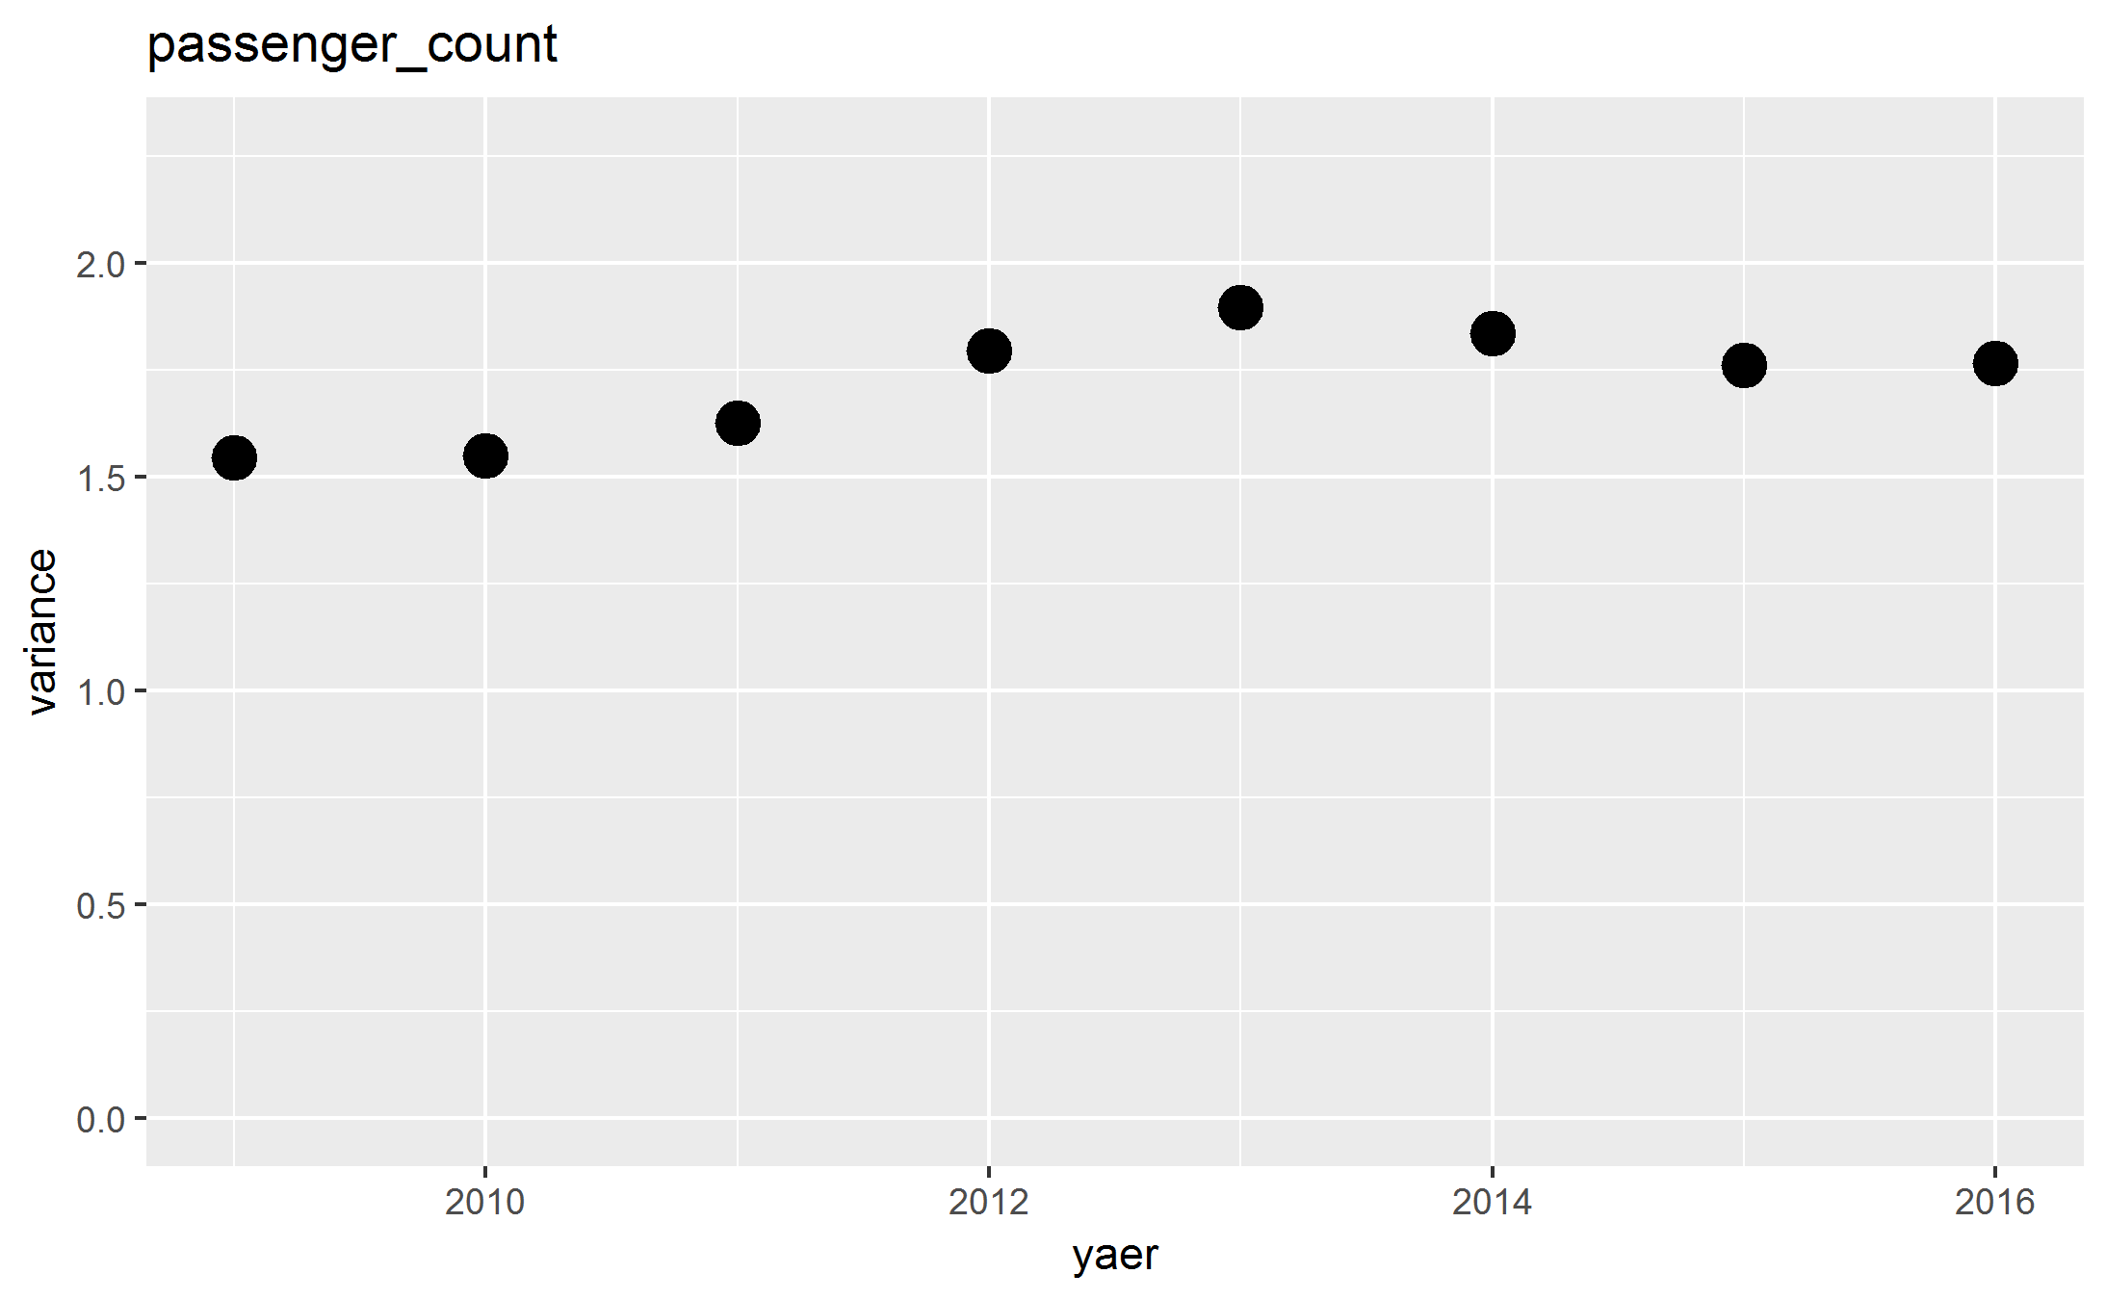

Variance and ANOVA test
The variance of the number of passengers increases after 2011 (uber came to NY).
Dose taxi lose their major type of passengers?
ANOVA show that the change of the number of passengers is significant after 2011
The result of ANOVA test
the number of passengers

Slide 2
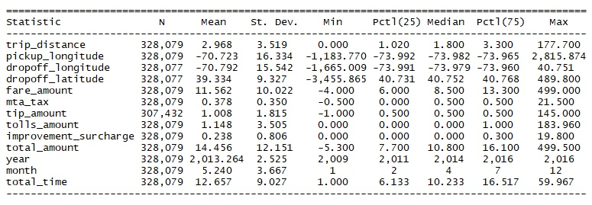
Descriptive Data Exploration

